Slide 1
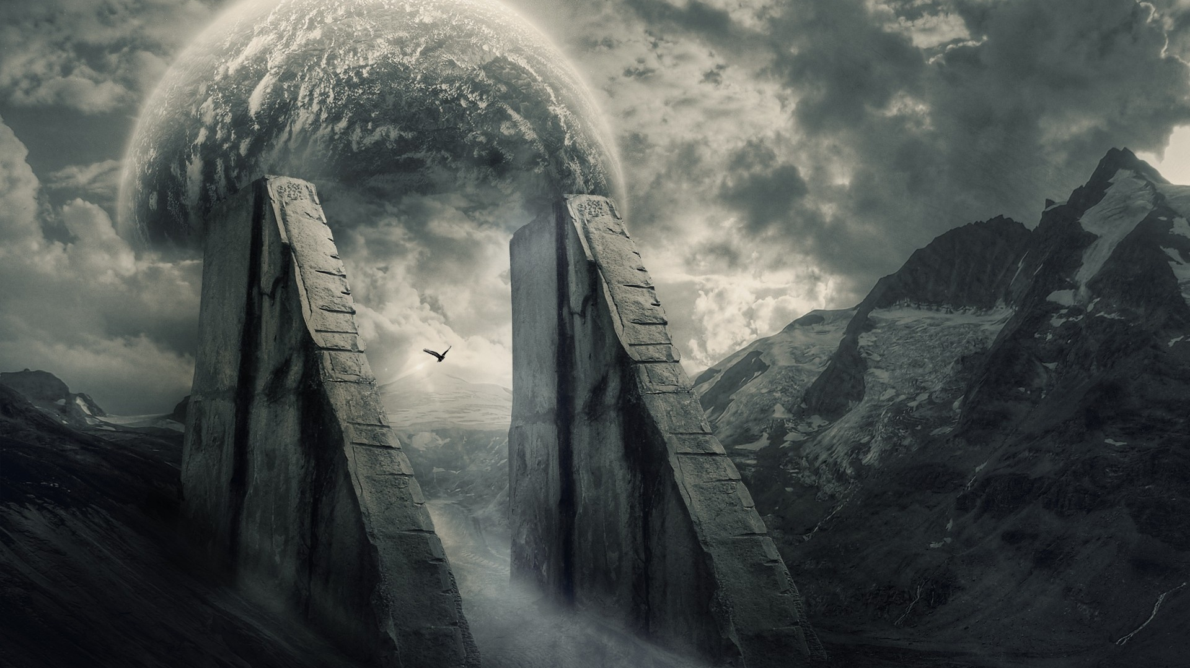
Blade of the Lost: The Silent Survivor Progress Report 2:
Developers: Josef Bacík (312553801) and Eduin Hernandez (艾德文 - 0860828)
Group #19
Instructor: 黃世強
https://wallpapersafari.com/w/Ppzkj5

Slide 2
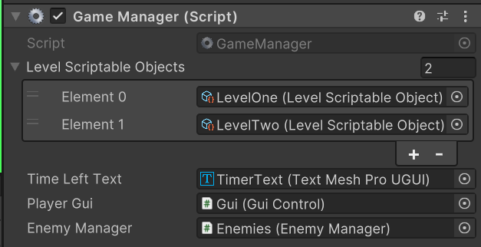
Wawe system
Game manager
Time based waves
Spawns enemies up to a limit
Each level has its own properties

Slide 3
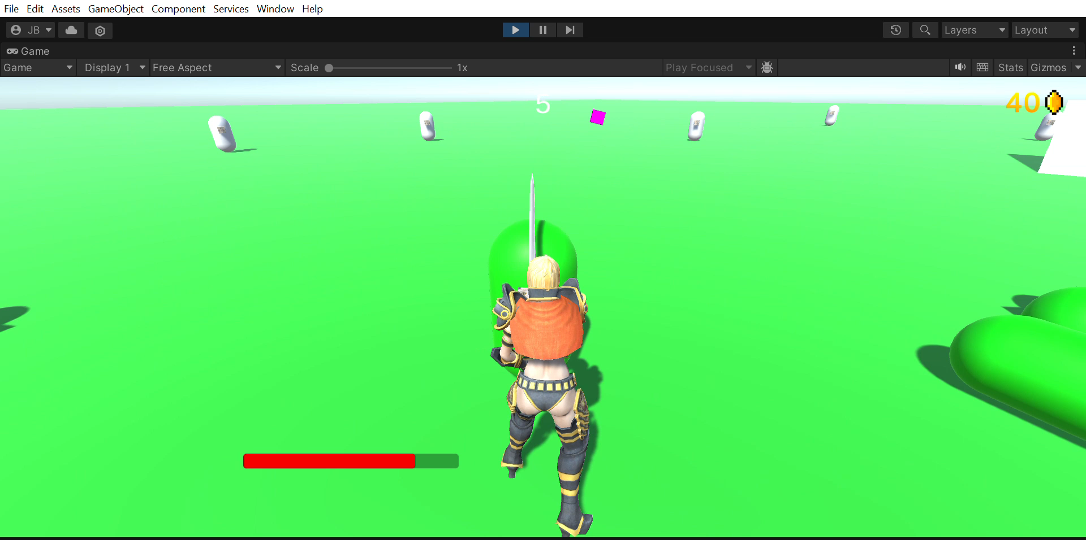
WaVe system

Slide 4
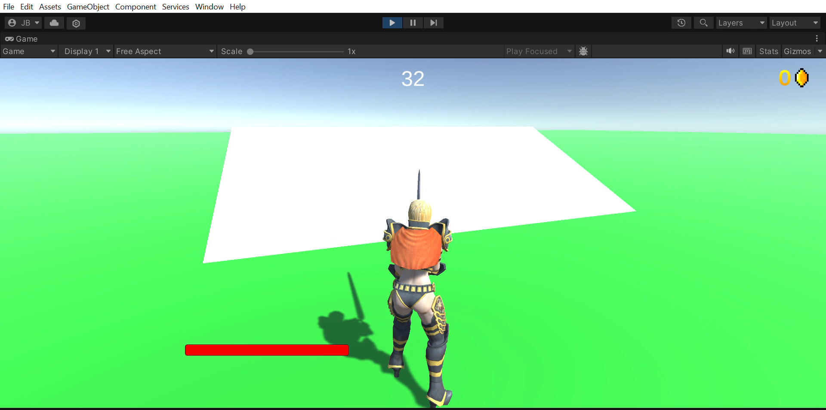
Better Camera
More expected camera manipulation
Scroll in and out
Maximum top and bottom view angle

Slide 5
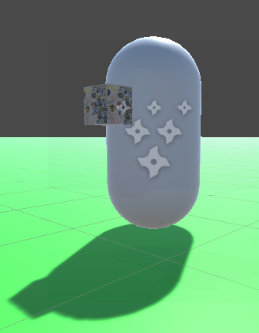
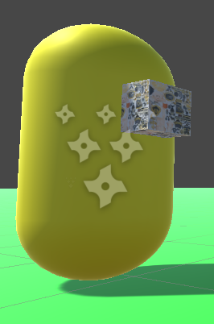
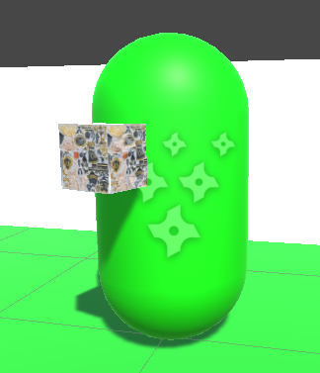
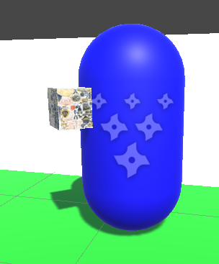
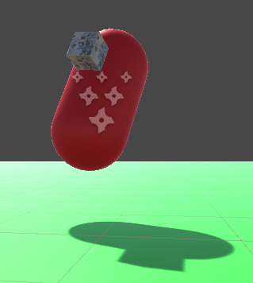
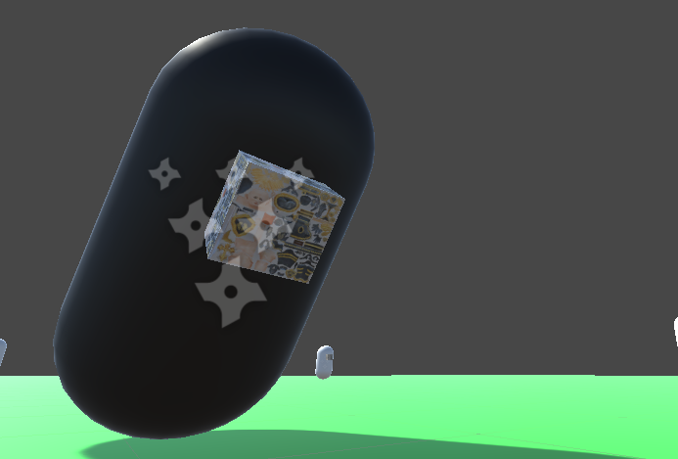
Enemy Behavior
Enemy Color Legend:
White: Idle
Yellow: Staggering
Green: Walking
Blue: Running
Red: Running and About to Explode
Black: Dead

Slide 6
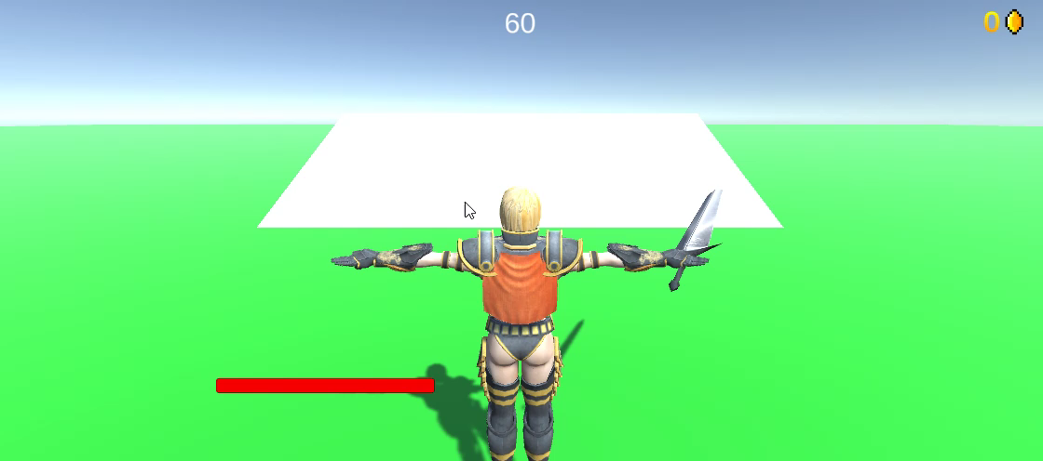

Enemy Behavior
CHARGING
IDLE

Slide 7

Enemy Behavior
Stagger
CHARGING
IDLE

Slide 8

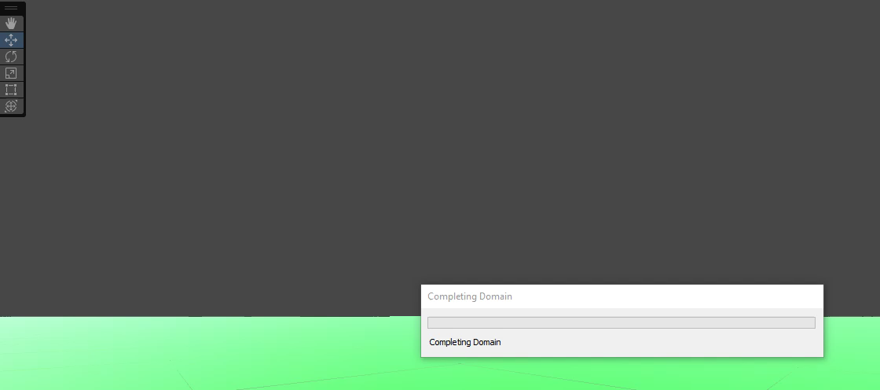
Enemy Emoticons & Health

Slide 9
Reference
Text Above Enemy: https://www.youtube.com/watch?v=_ICCSDmLCX4
Sound Clips: https://gamedevbeginner.com/how-to-play-audio-in-unity-with-examples/
Load Sound Clips: https://github.com/deadlyfingers/UnityWav/tree/master

Slide 10
THANK YOU!

